Slide 1

NYHDIF March 2019
Update
Lee Rickles
Twitter @YHCareRecord
Email hnf-tr.yhcr@nhs.net

Slide 2
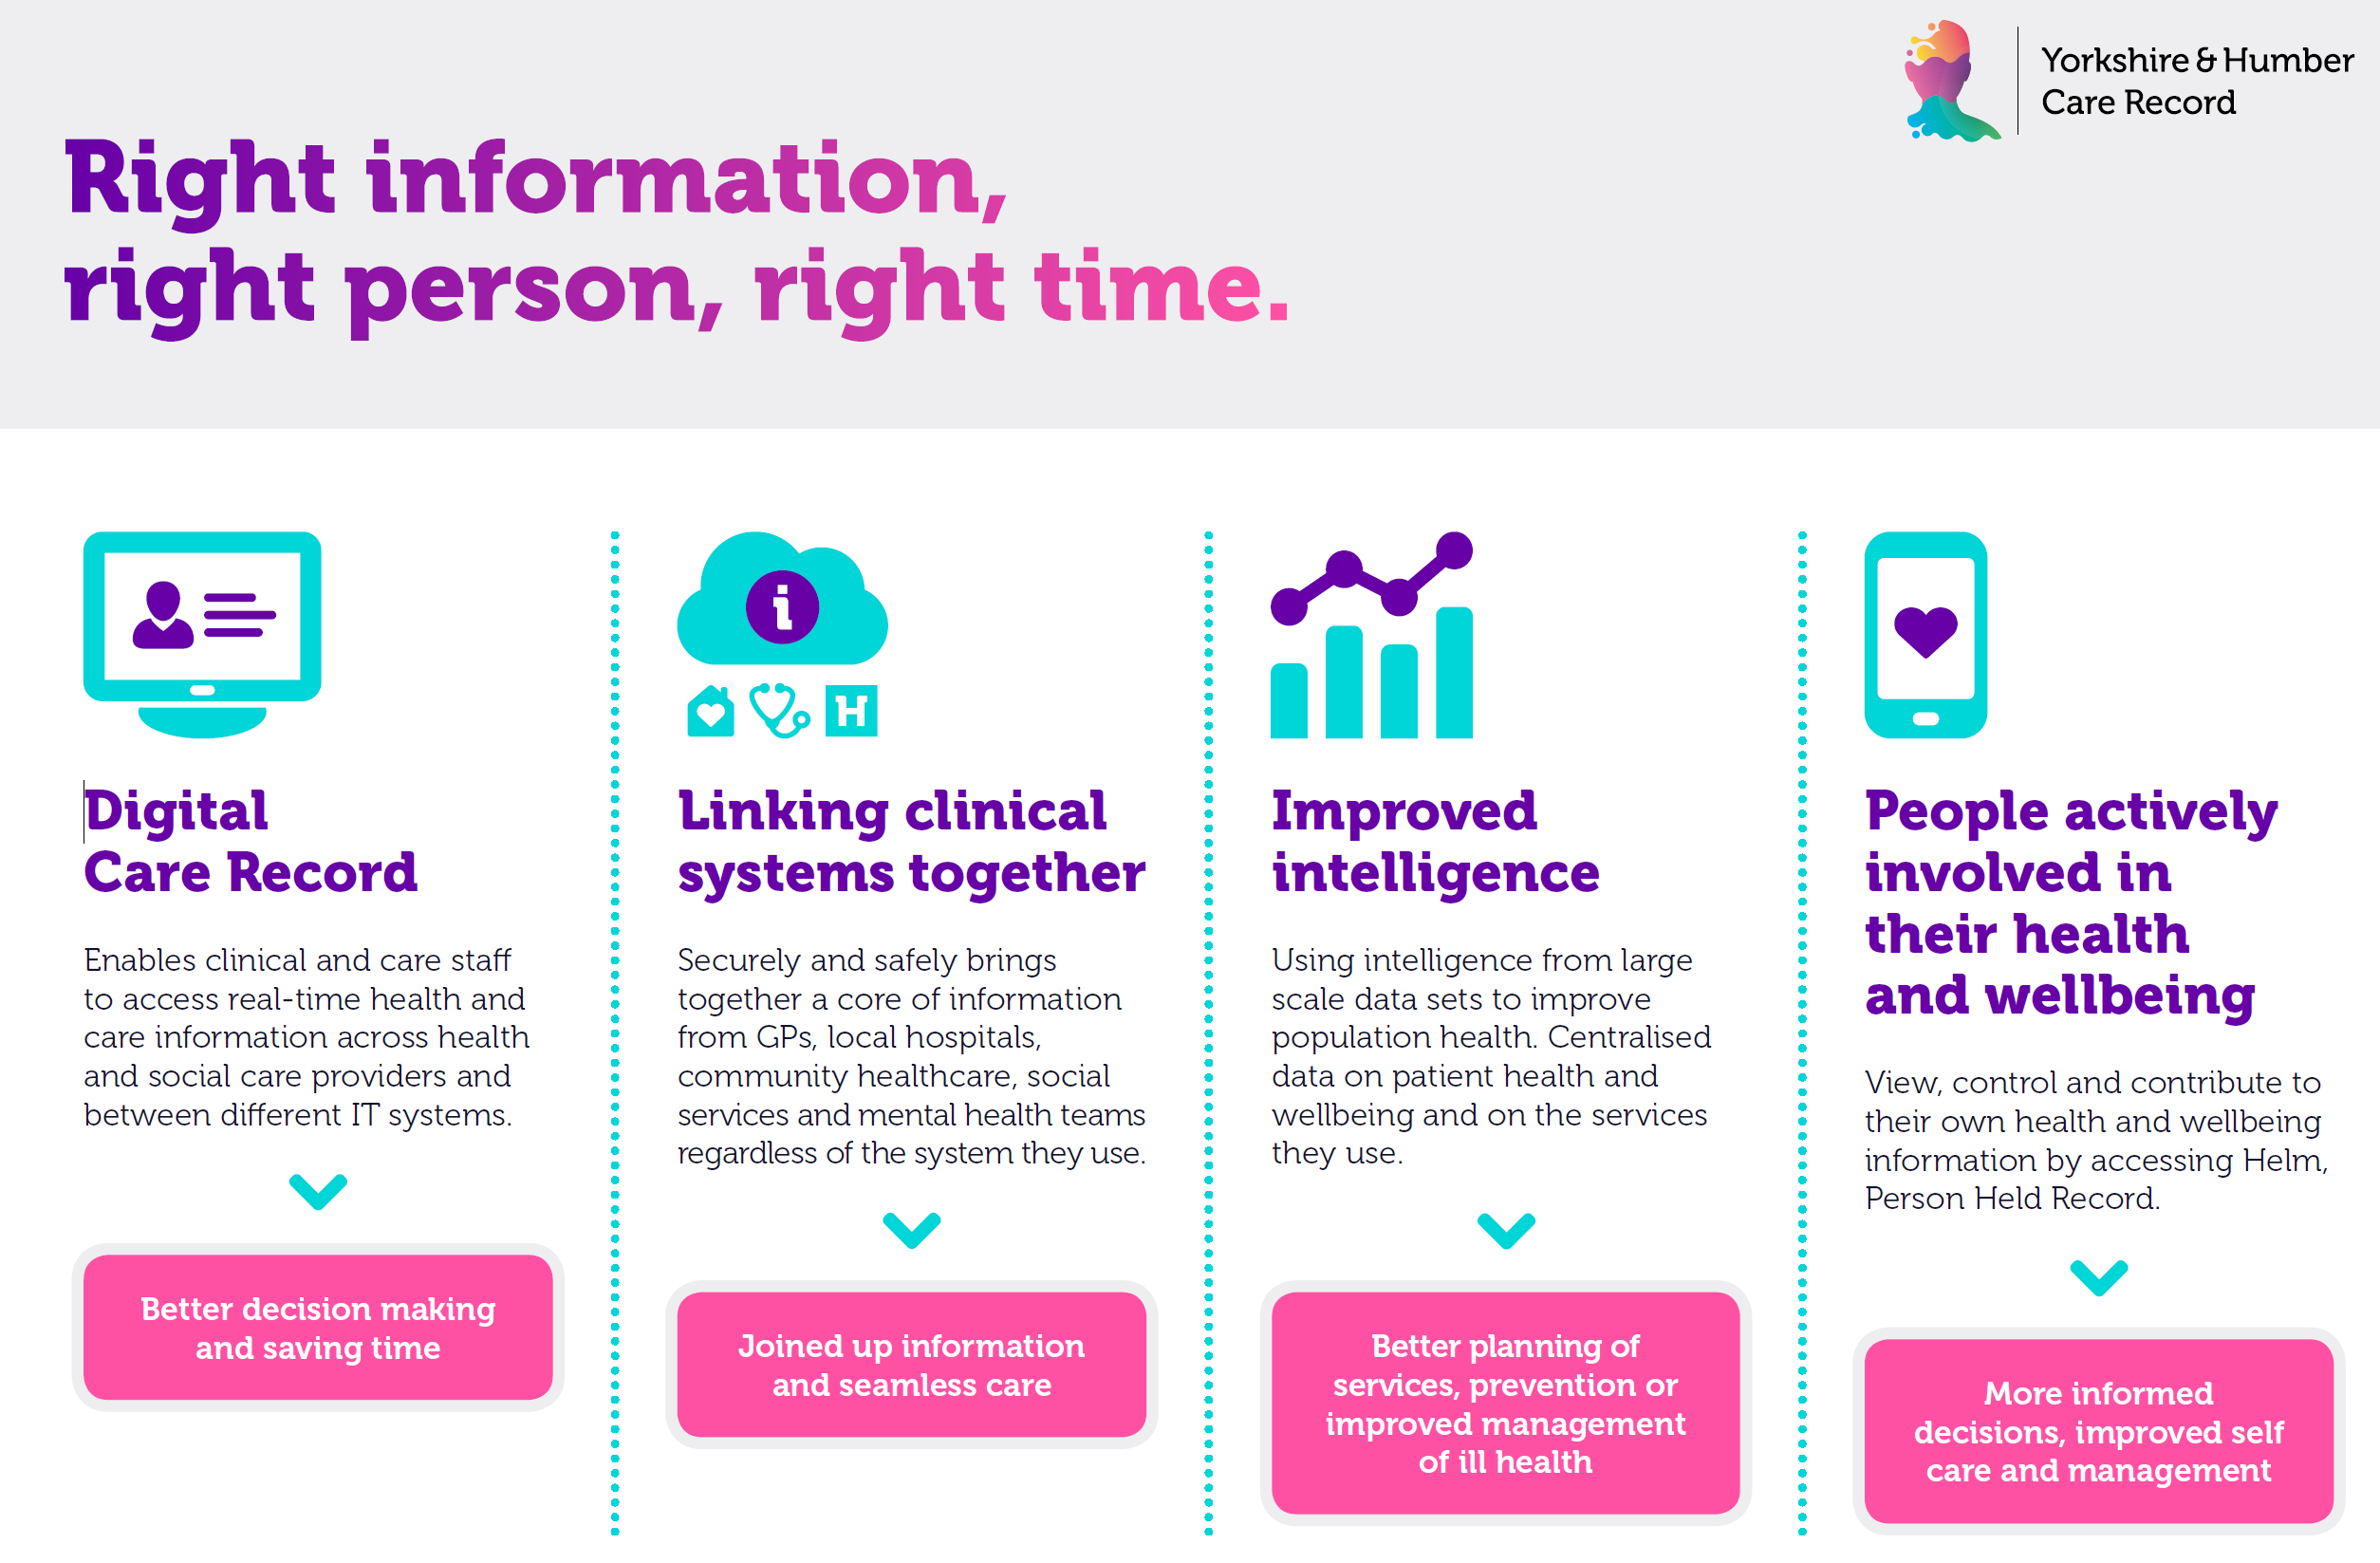

Slide 3
Progress
Systems of Systems region integration hub has been commissioned.
Wave 1 Systems of System site; Leeds Hospital, Rotherham Hospital and Humber Teaching are now flowing data. Doncaster & Bassetlaw Hospital and YAS soon to follow. replaced Rotherham Council in wave 1. All wave 1 are planned to be completed April 2019.
Specification for region wide population health solution has been drafted and is going to market. Planned award by the end of April 2019.
Professional services tender has been completed
Joinedup Yorkshire & Humber public engagement completed
9 GP practices from Humber, Coast and Vale are loading information into the revamped Leeds Care Record
Digital baseline assessment nearing completion

Slide 4
Progress
£3.15M capital has been released for FY19/20.
£4.35M capital is planned for FY20/21
Yorkshire & Humber Digital Care Board has agreed to fund the first two substantive positions (CTO and Architect) in the Digital Care Team
The next Yorkshire & Humber Care Record Delivery Board is scheduled for the 13 March 2019
Cyber security review to take place in March 2019
A new SRO is being recruited to replace Richard Corbridge
Learning from Local event being scheduled for 13 June 2019
Planning with each ICS/STP for FY20/21 to take place in March 2019

Slide 5
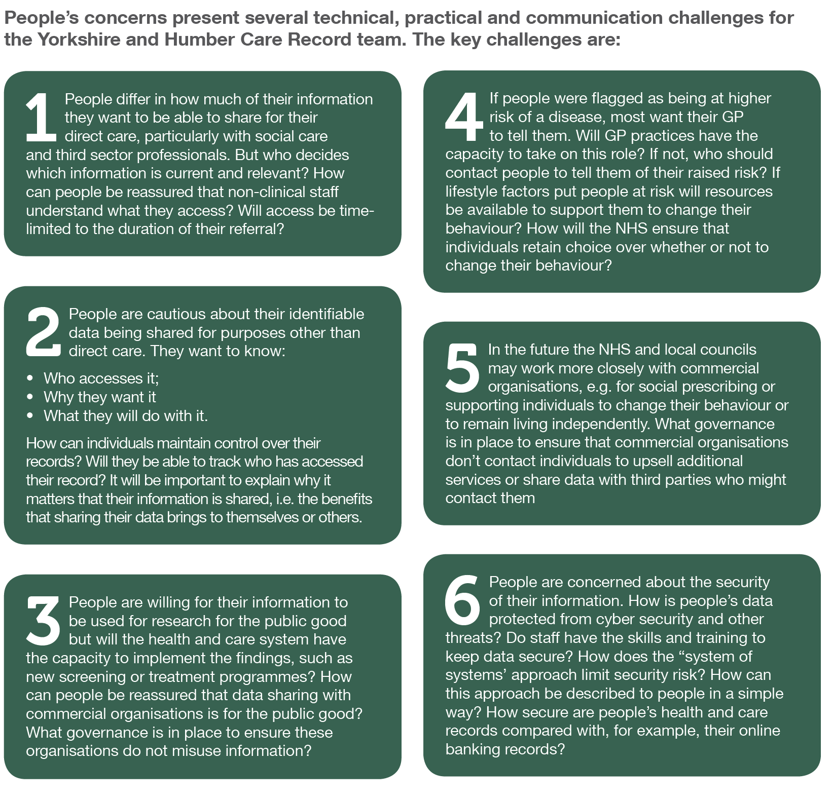
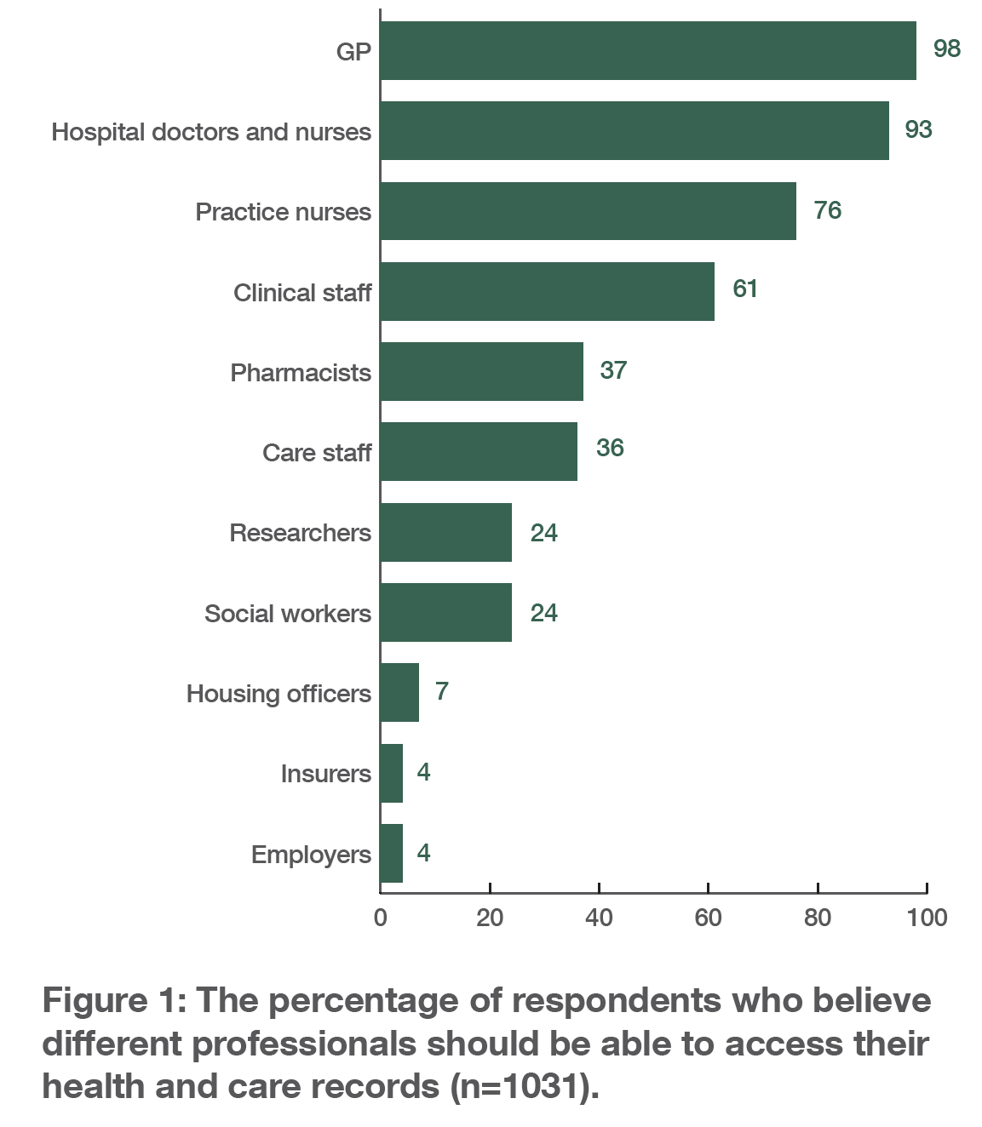
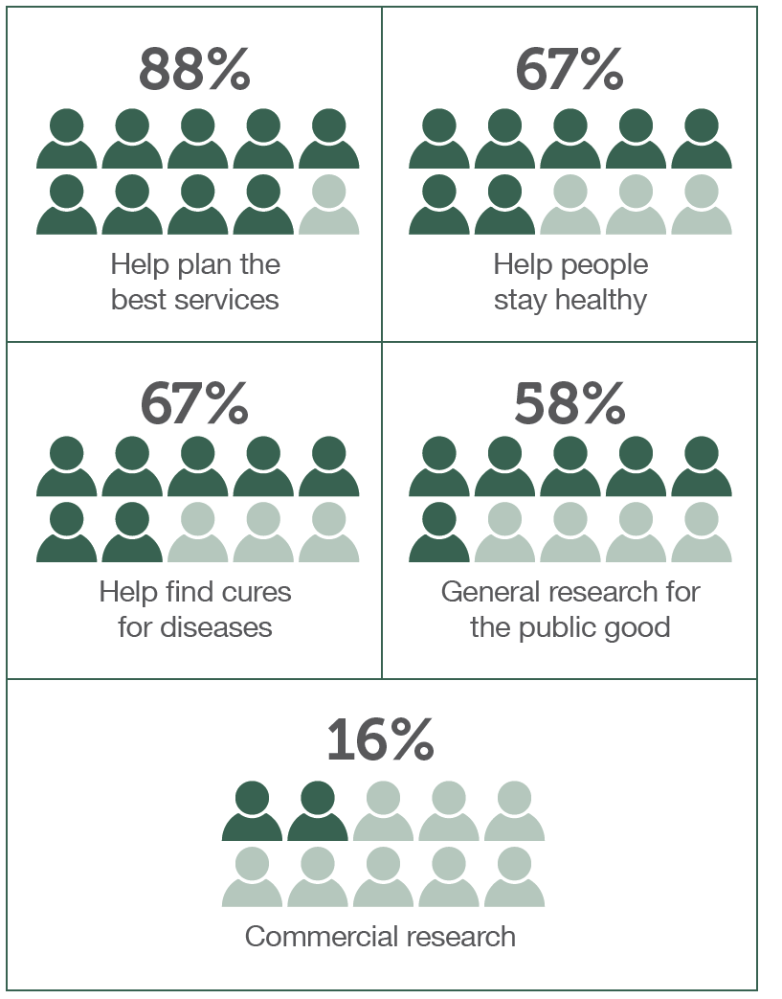
Summary of Joinedup
Yorkshire & Humber

